Slide 1

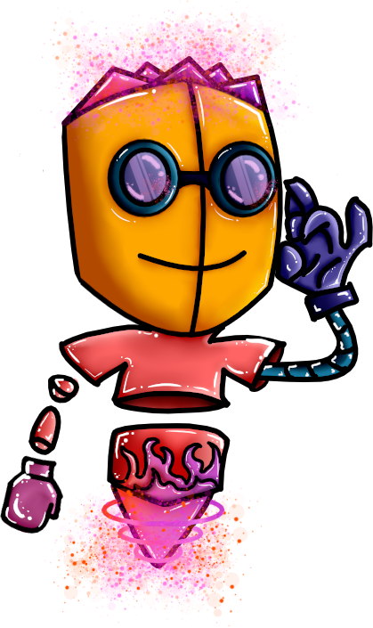

TYPHON
Code Sprint Project 2020
Hi this is G-Bot he will be taking care of you while we are presenting.

Slide 2
Typhon's team
Scrum Trainer: Georgi Dryanovski - 9А class
Front-End: Yoan Tanev - 9А class
Back-End: Viktor Kirov - 9G class
Code Checker: Maksimiliyan Dimov - 9А class
2

Slide 3
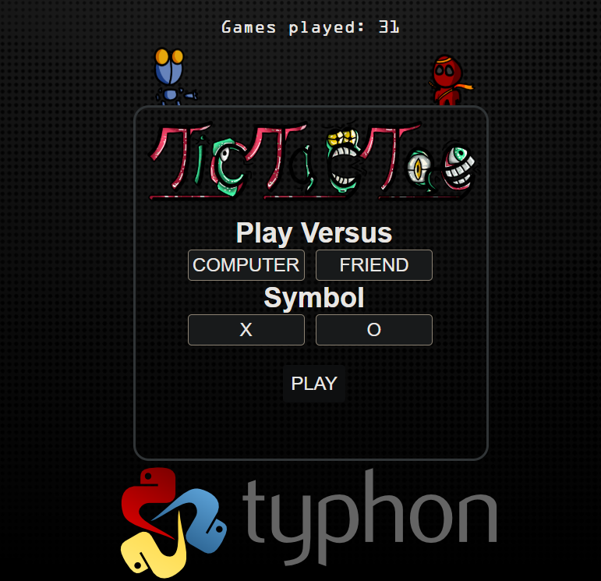

Idea
3

Slide 4





Concepts used
4

Slide 5




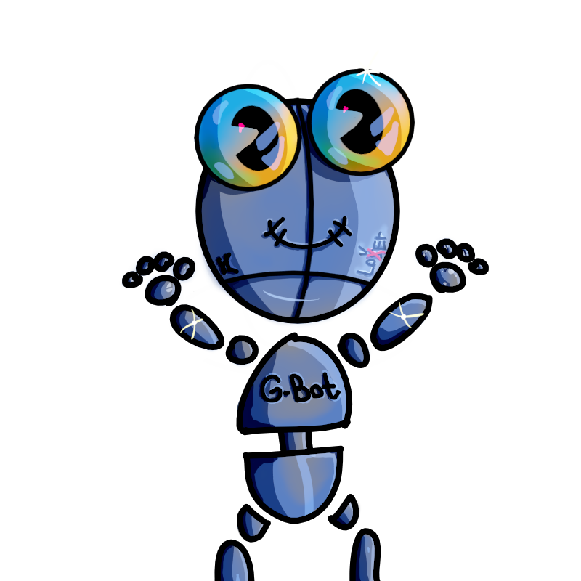


5

Slide 6
Future Ideas
New unlockables
Achievements
Several games
A.I. configuring tool
6

Slide 7


Slide 8
That's it from us! Thank you for your attention!

